Slide 1
Our SCHOOL CULTURE
Pre-AICE Biology Final Project

Slide 2
What does “school culture” mean?
“School culture generally refers to the beliefs, perceptions, relationships, attitudes, and written and unwritten rules that shape and influence every aspect of how a school functions, but the term also encompasses more concrete issues such as the physical and emotional safety of students, the orderliness of classrooms and public spaces, or the degree to which a school embraces and celebrates racial, ethnic, linguistic, or cultural diversity.” (http://edglossary.org/school-culture/)

Slide 4
How would you define our school culture?

Slide 5
Your ASSIGNMENT:
Working in groups of 2-4, select 2 components of “Surface culture” and 2 components of “Deep culture” to showcase how our school, community, or even Florida demonstrates those components of culture.

Slide 6
Your ASSIGNMENT: (continued…)
2) You will create a visual presentation of photos, videos, etc. showcasing your 4 chosen components of our school culture.

Slide 7
Your ASSIGNMENT: (continued…)
3) Your visual presentation must include photos/video of your group members and actual PPCHS students, faculty, staff and community members.

Slide 8
Your group will present your project in class
on THURSDAY,
6/1!

Slide 9
Project REQUIREMENTS:
Final Presentations must be under 5 mins. (with videos)
Project must clearly identify your 2 surface & 2 deep facets of culture that you explored.
This is a visual presentation project! Assume the audience are not fluent in English, or familiar with our American culture, etc. Therefore- Limit words but provide short captions/labels.
*Think about stereotypes and try to best represent
our very diverse school!

Slide 10
ExAMPLE: Switzerland culture
SURFACE CULTURE: Food - Chocolate, Fondue

Slide 11
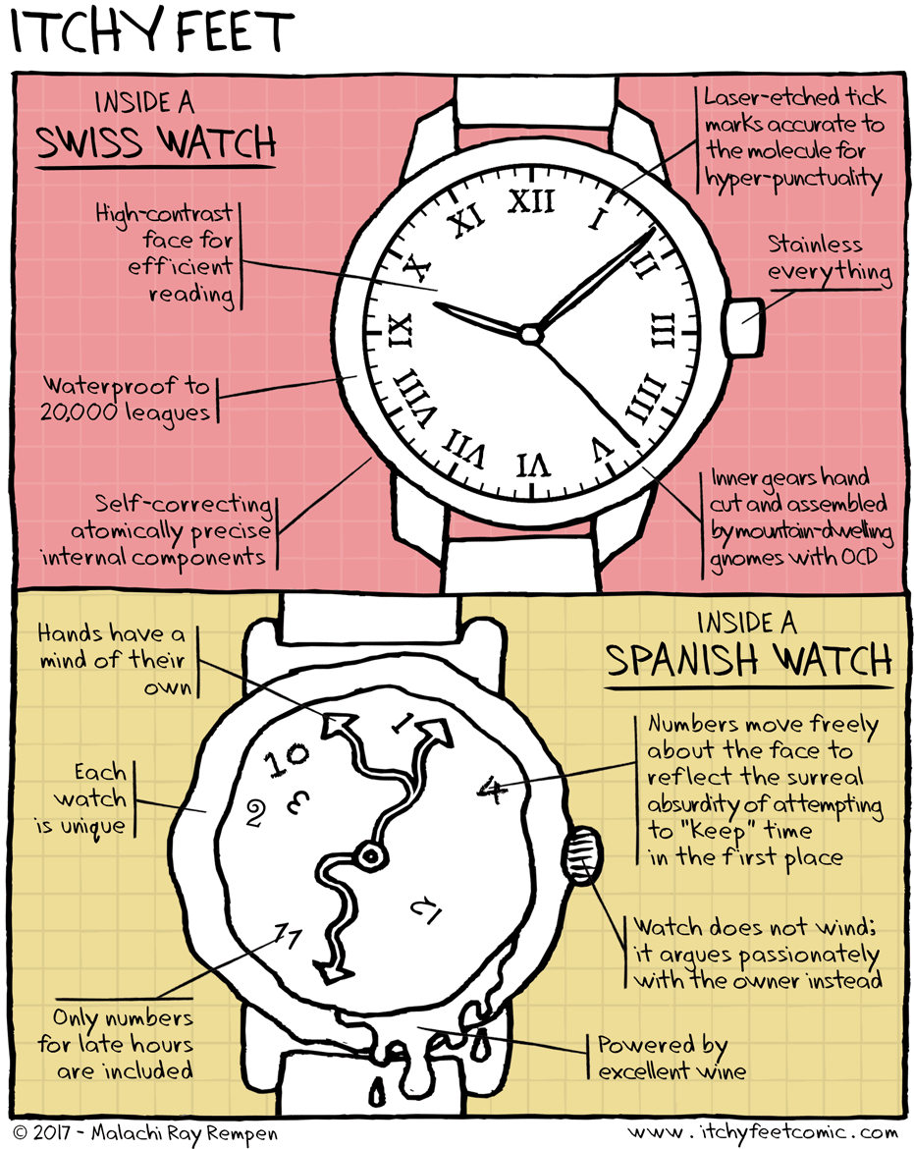
ExAMPLE: Switzerland culture
DEEP CULTURE: Concepts of Time - Punctuality

Slide 12
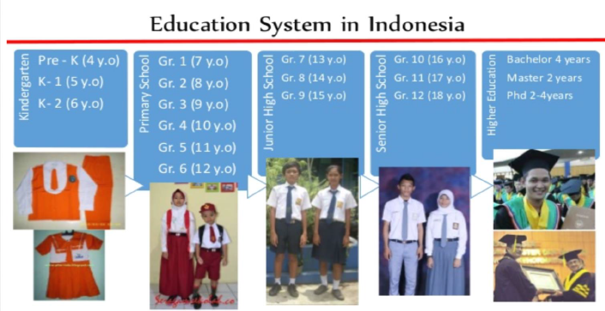
SAMPLE: Indonesian culture
Surface Culture- school uniforms
Deep Culture- the “Indonesian No”

Slide 13
Project Format and grading:
There is no set format to use. As long as you meet the requirements listed, you can be as creative as you wish!
Think about the best way to showcase that facet of our school culture to a global audience!
GRADE: 100 points (Tests/Project category)
(80 points group grade + 20 points individual grade)
*Rubric will be available online on 5/26!

